Slide 1
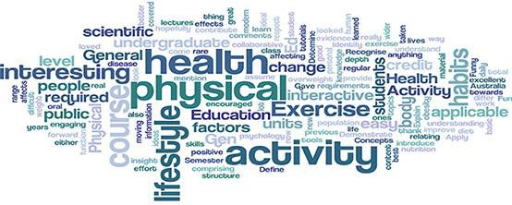
Physical Activity and
Health
Session 1
Context and History of PA
and Health

Slide 2
Module Learning Outcomes
Demonstrate a critical awareness of both the importance of physical activity from a public health perspective and the impact of public health physical activity initiatives in the UK.
Demonstrate a critical understanding of the role that physical activity plays in promoting the health and wellbeing of different populations (children, older adults, ethnic minorities, etc.) and within different settings.
Critically evaluate the evidence for health outcomes associated with physical activity and sedentary behaviour.
Critically appraise the key principles, approaches and outcomes of existing interventions for physical activity promotion.
Understand and apply epidemiological principles and terminology relating to physical activity and sedentary behaviour.

Slide 3
Session Learning Outcomes
Define key concepts in physical activity (PA) and health;
Examine human evolution in the context of PA and health;
Discuss the burden of chronic disease and the effect of PA;
Define key terms in PA and health;
Be able to identify and discuss key definitive contributors to
the field of PA and health.

Slide 4
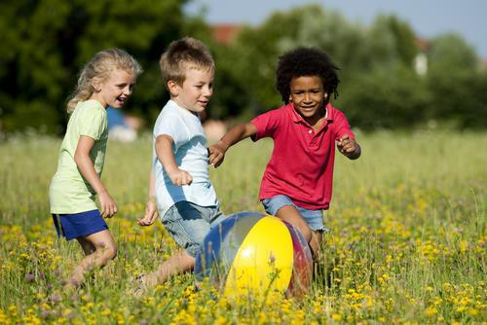
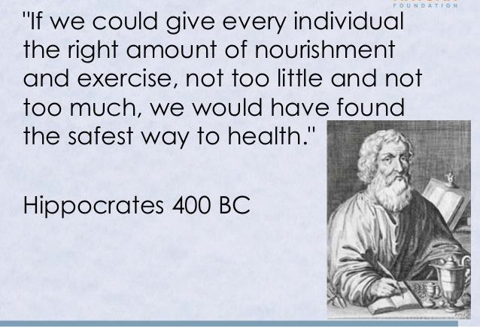
Philosophers and physicians have known about the connection between physical activity and health throughout recorded history
“Lack of activity destroys the good condition of every human being while movement and methodical physical exercise save it and preserve it”
“To keep the body
in good health is a duty...otherwise we shall not be able to keep our mind strong and clear.”
Buddha 600 BC
Plato 400 BC

Slide 5
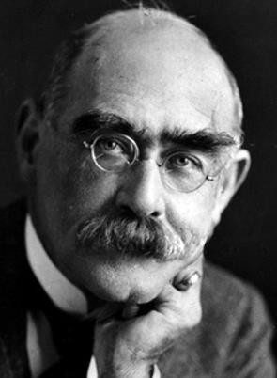
Rudyard Kipling (1980)
‘The cure for this ill is not to still
still,
Or frowst with a book by the
fire;
But to take a large hoe and a
shovel also,
And dig till you gently perspire’.

Slide 6
What is Health?
By far, the most widely used definition is that of the World Health Organization:
“[Health is] the state of complete physical, mental and social well-being and not merely the absence of disease or infirmity” (WHO, 1948) and the “extent to which an individual or group is able to realize aspirations and satisfy needs, and to change or cope with the environment. Health is a resource for everyday life, not the objective of living; it is a positive concept, emphasizing social and personal
resources as well as physical capabilities” (WHO, 1984).

Slide 7

What is Health?
“The state of being free from illness or injury”
(Oxford Online Dictionary)
Huber et al., (2011) ‘How should we define health?’ (BMJ paper on Blackboard)

Slide 8
4 evolutionary periods in time
Pre-agricultural period
Agricultural period
Industrial period
Nuclear / technological period
Blair (1988)

Slide 9
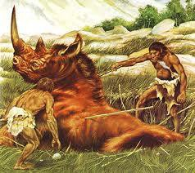
Pre-agricultural period
10,000 years ago
Hunter – gatherer period
PA was high, diet was low in
fat
Average LE = 20 – 25 years

Slide 10
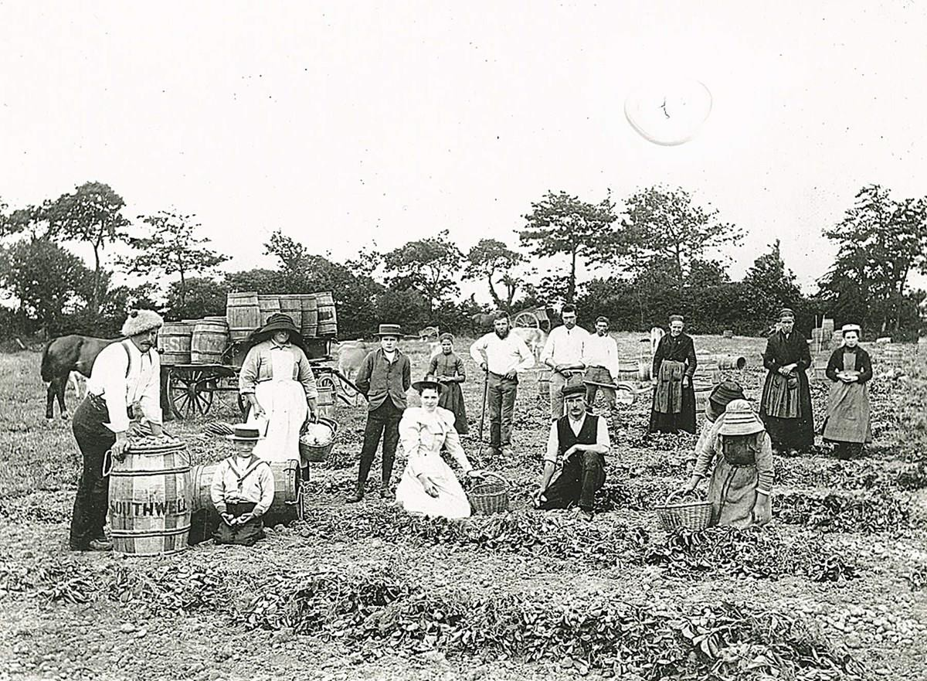
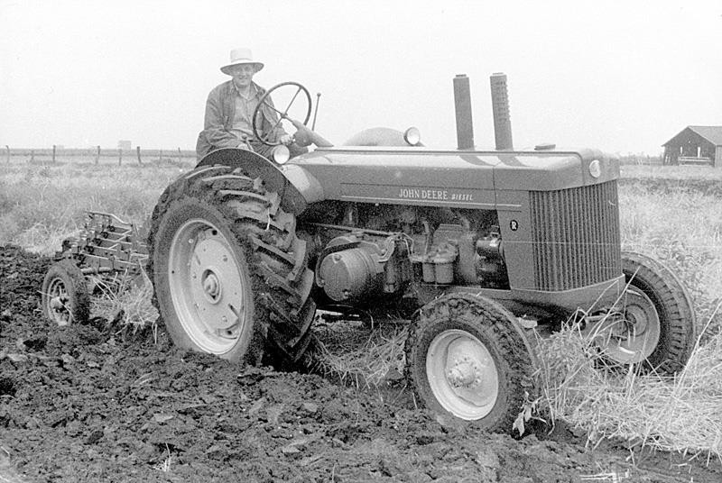
Agricultural period
From 10,000 years ago to beginning of
C19
High PA levels
Fat content of diet increasing
Average LE = 38 years

Slide 11
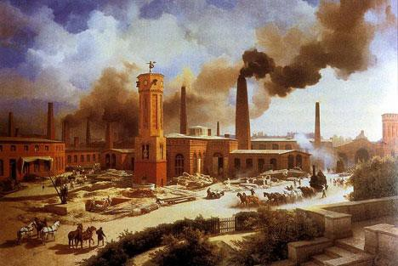
Industrial period
1800-1945
An ‘industrialised’ society
– Overcrowding, poor diet (more sugar), poor public health
measures, inadequate medical facilities and care
Infectious diseases caused premature deaths (average LE = 43
years)

Slide 12

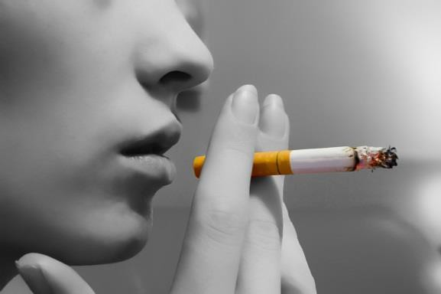

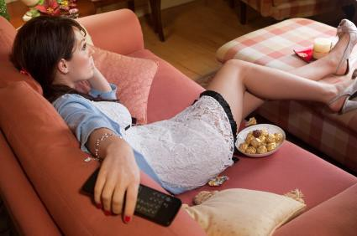
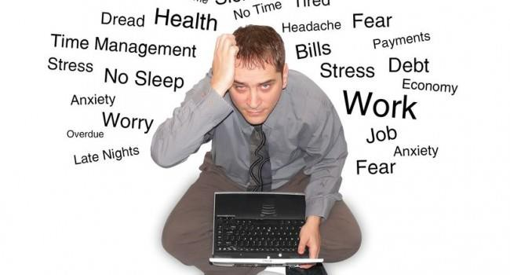
Nuclear / technological period 1945 – present day
Infectious diseases less common
Major causes of premature mortality now lifestyle related

Slide 13
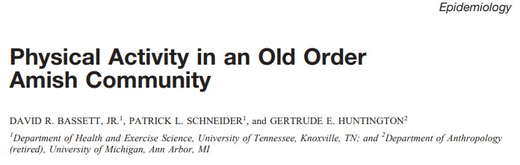
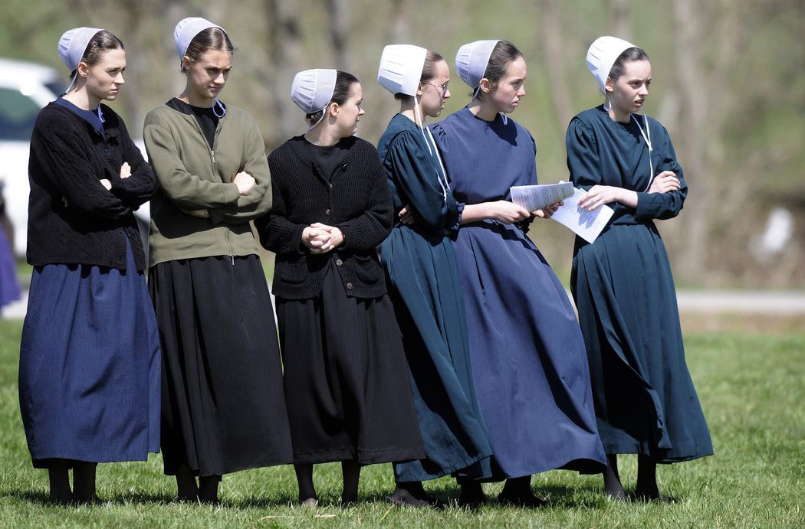
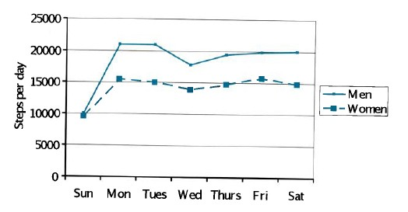

Slide 14
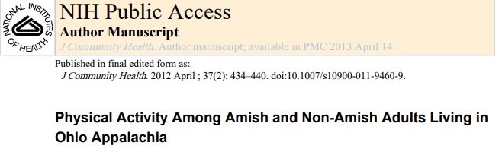
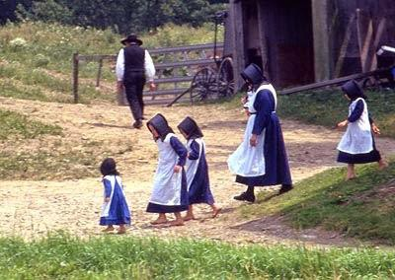

Slide 15


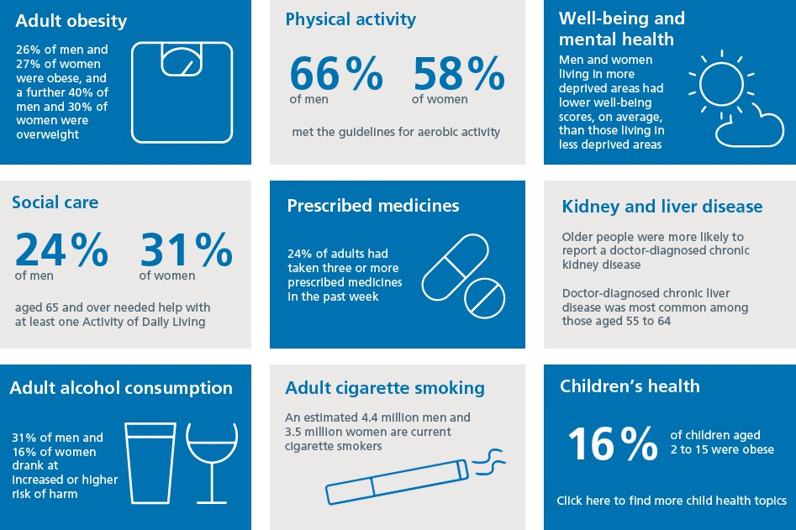
Health Survey for England 2016

Slide 16

Physical Activity Transition
(Katzmarzyk and Mason, 2009)
From active to inactive

Slide 17

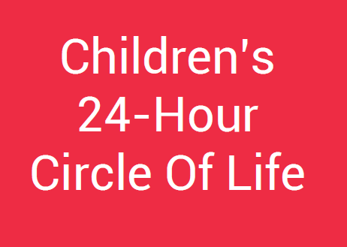
‘By the time they finish primary school many children have the highest levels of body fat on record. Rates of child Type 2 diabetes and mental illness are also the highest in our history. Children now sleep less and have the highest level of admissions to NHS hospitals for sleep disorders. At the same time British children are spending the highest ever amount of their discretionary time in front of screens, and young children have never moved so little.’

Slide 18
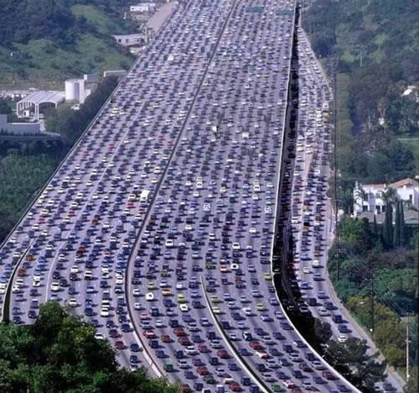
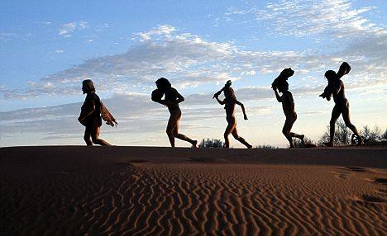
Physical Activity Transition
(Katzmarzyk and Mason, 2009)

Slide 19
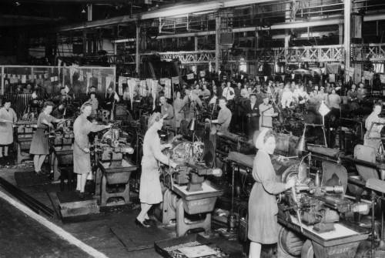

Changing work practices

Slide 20
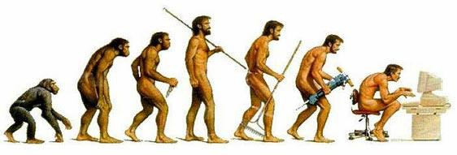

Slide 21
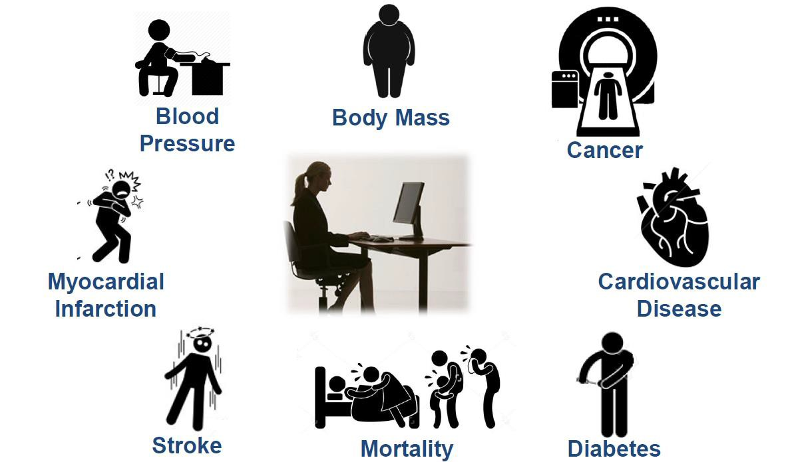
Sitting and Health

Slide 22

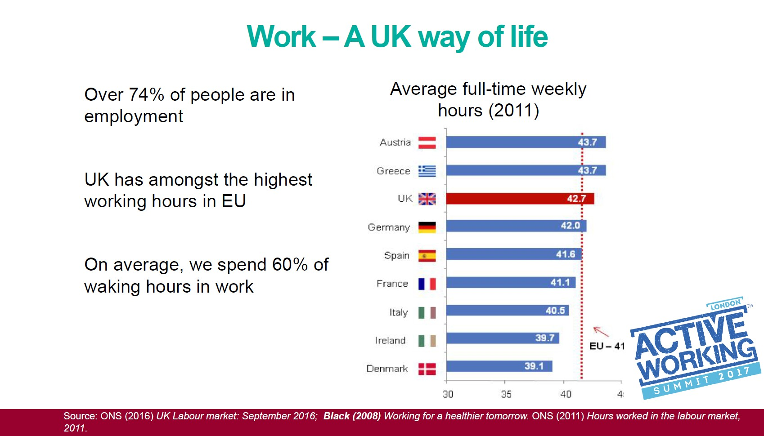

Slide 23

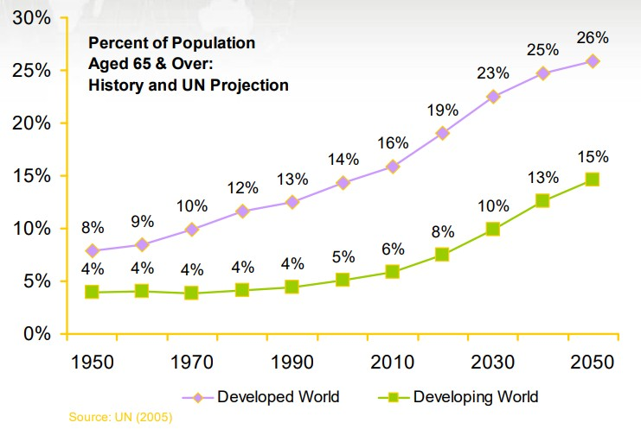
Trends in Global Ageing

Slide 24
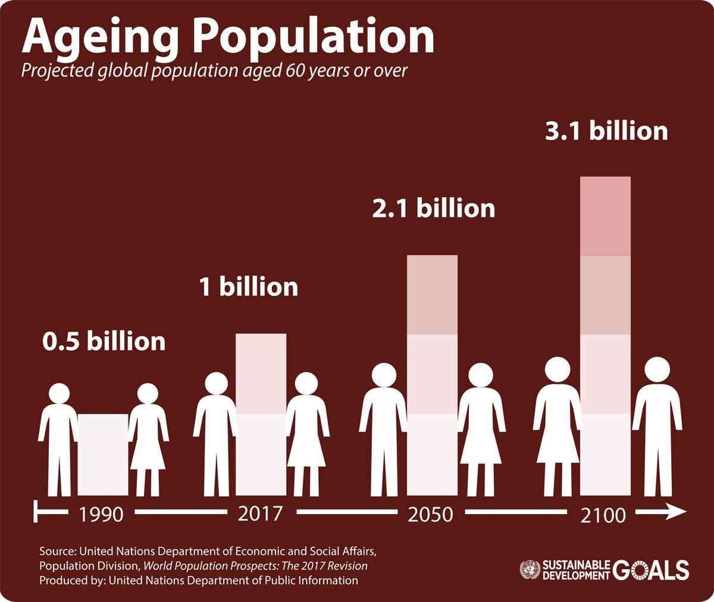

Slide 25
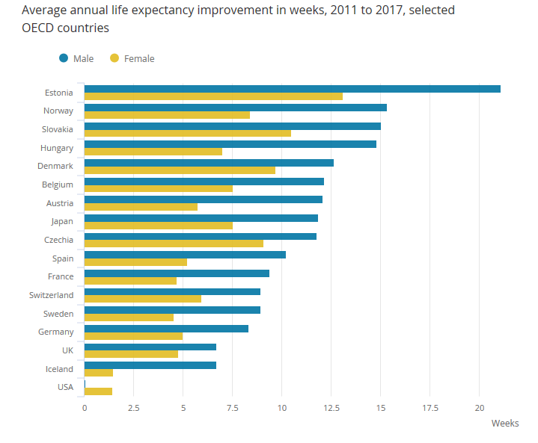
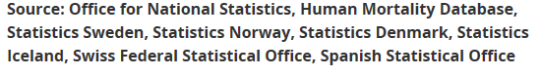
Life expectancy
improvements

Slide 26

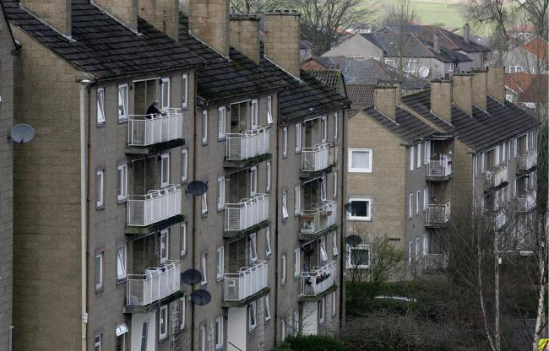
Life Expectancy (LE) UK (ONS, 2018)
Females in London Borough of Camden highest LE of 86.5
years
Males in Hampshire district of Hart highest at 83.3 years
Lowest for both is in Glasgow City 73.3 for males, 78.7 for
females

Slide 27
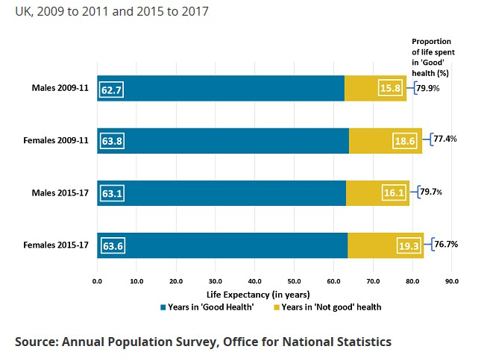
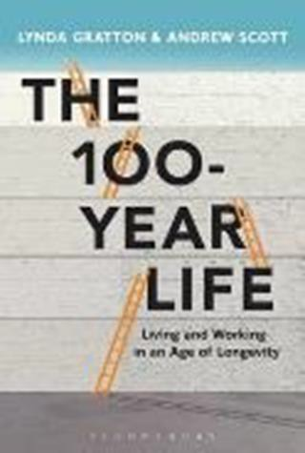
Healthy life expectancy UK (ONS, 2018)

Slide 28
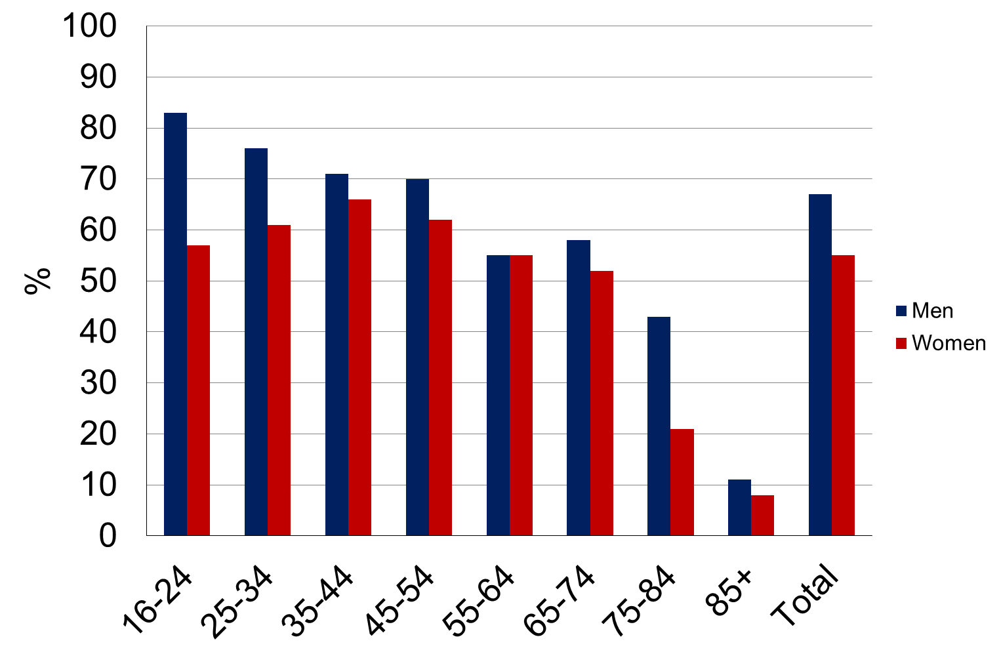
We do less activity as we age
(Health and Safety Executive 2014)
Biggest drop

Slide 29
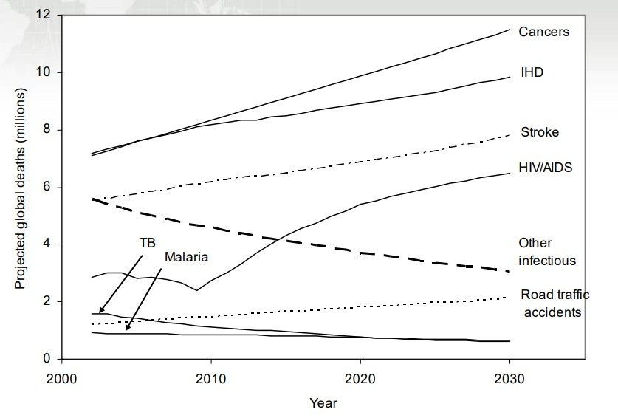
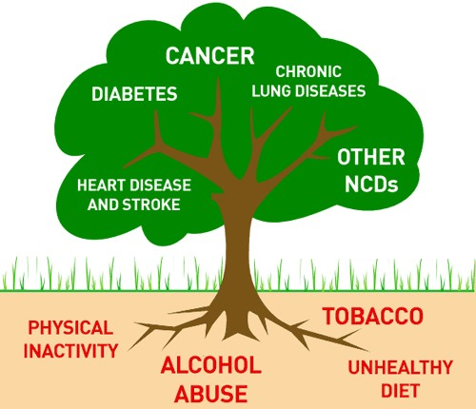

The epidemiological transition
WHO, 2007

Slide 30
Three main behaviours…..
That cause one-third of (preventable) deaths in developed countries;
–Smoking
–Poor diet
–Physical inactivity
(Hardman and Stensil 2009)

Slide 31
Three modern trends…..
That will increase the prevalence of NCDs in this century;
–Epidemic of obesity
–Inactivity in children
–Increasing age of the population
(Hardman and Stensil 2009)

Slide 32
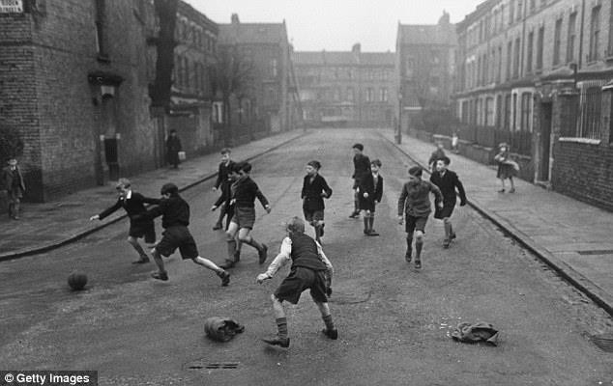
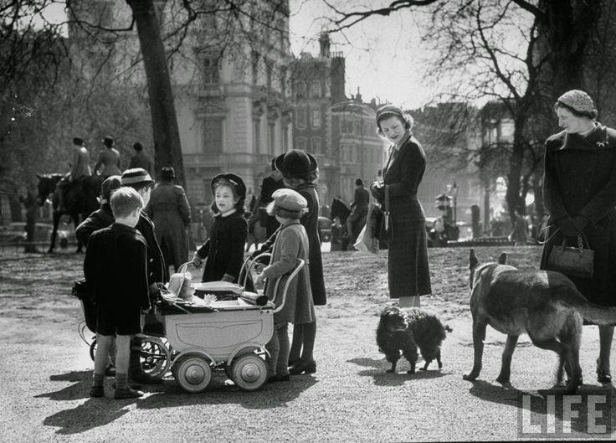
Decreased levels of daily energy expenditure
(James 1995 in: Hardman and Stencil 2009)
Average daily decline in daily energy expenditure since 1942 to 1995 is 800 kcal
(equivalent of walking 10 miles).

Slide 33
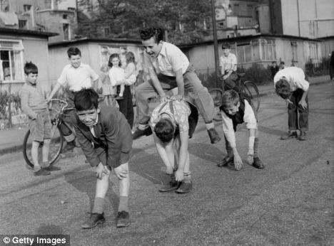
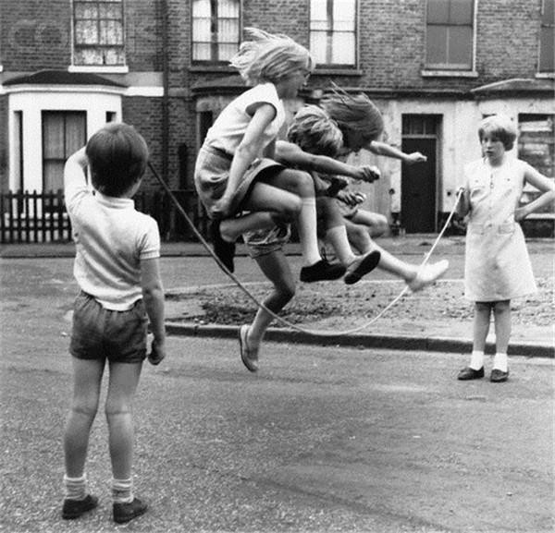
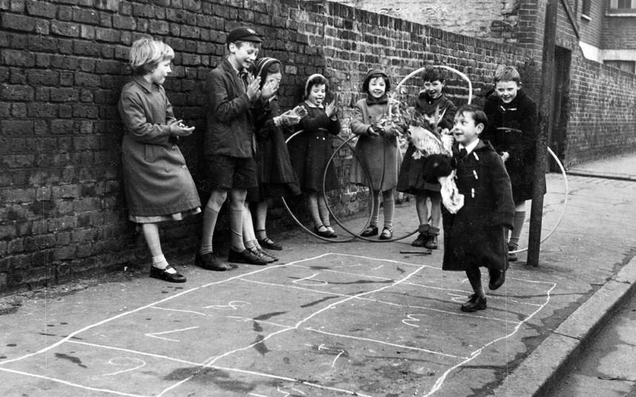
1960s children’s activity

Slide 34
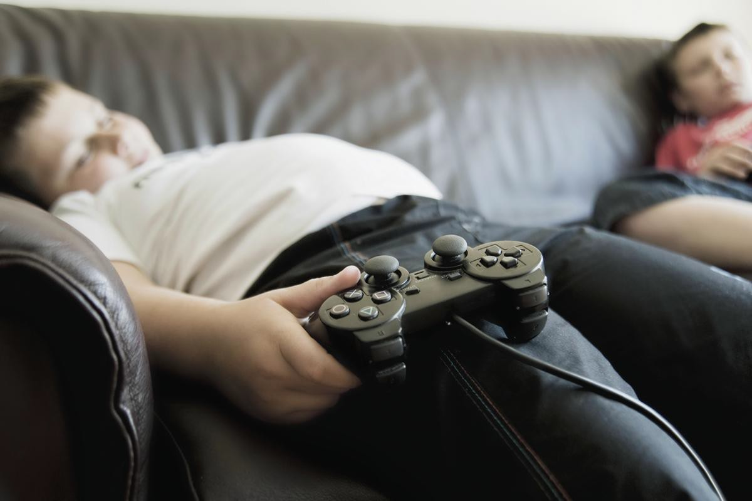


2021 children’s activity

Slide 35
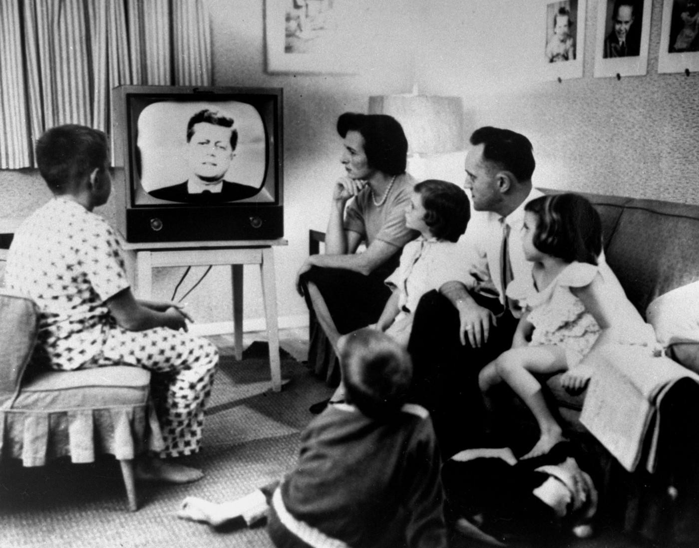
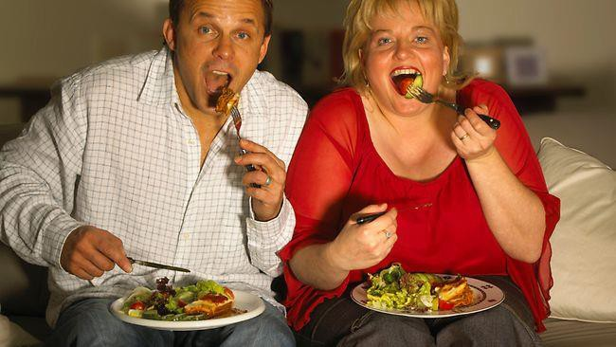
Watching TV
2.5 TVs per average
household

Slide 36

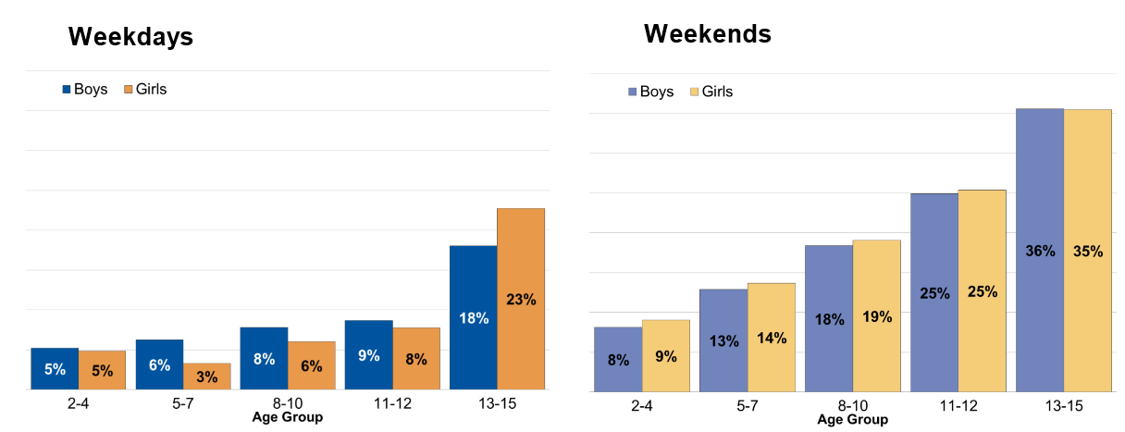
Time spent sedentary in leisure time (6 hoursor more)
Children aged 2-15 years; 2015

Slide 37
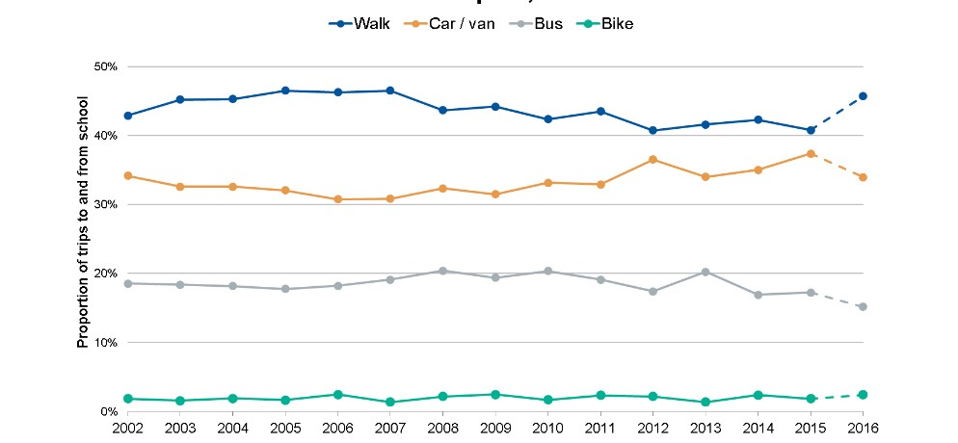
Trends in travel to school
Children aged 5-16years; 2002 to 2016

Slide 38
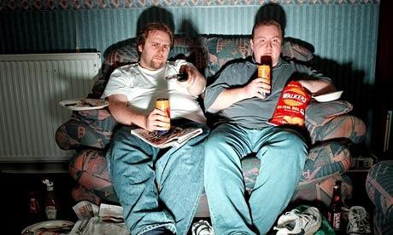
“We in the West are the first generation in human history in which the mass of the population has to deliberately exercise to be healthy. How can society’s collective adaptations match?”
Morris 2009

Slide 39


A perfect storm?

Slide 40
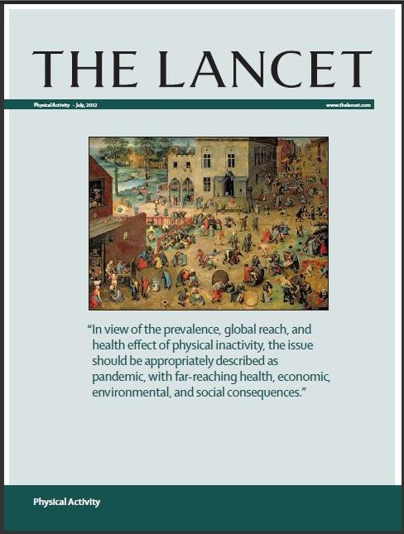
“In view of the prevalence, global reach and health effect of physical inactivity, the issue should be appropriately described as pandemic, with far-reaching health, economic, environmental and social consequences.”
July 2012

Slide 41
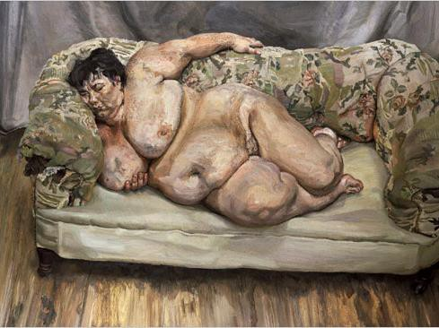
If current trends
continue...
It is estimated that by 2020 the average British citizen is expected to become so sedentary they will expend only 25% more energy per day then if they spent the whole day sleeping (Walking Works, 2013).

Slide 42

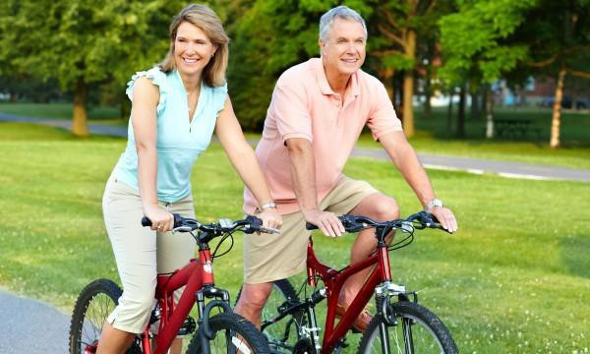


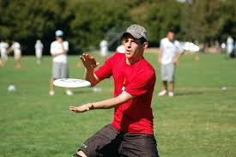
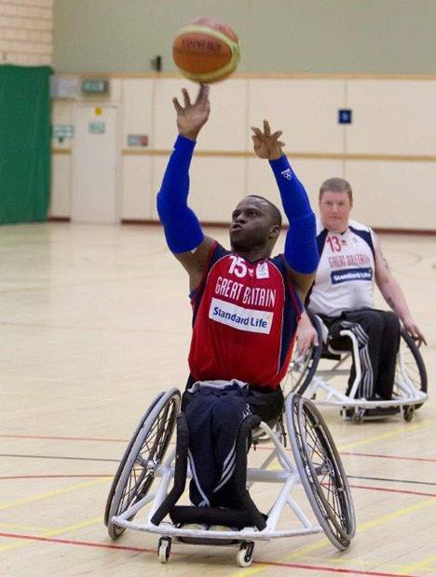



WHAT IS PHYSICAL ACTIVITY?

Slide 43
Key definitions
Physical activity;
‘any bodily movement produced by skeletal muscles that results in energy expenditure’ (Casperson et al., 1985)
Physical inactivity;
‘An insufficient physical activity level to meet present
physical activity recommendations’ (Tremblay et al., 2017)

Slide 44
Key definitions
Sedentary behaviour;
‘any waking behavior characterized by an energy
expenditure ≤1.5 metabolic equivalents (METs),
while in a sitting, reclining or lying posture’ (Tremblay et al., 2017)
Exercise;
‘a subset of physical activity that is planned, structured, and repetitive and has as a final or an intermediate objective the improvement or maintenance of physical fitness’ (Casperson et al., 1985)

Slide 45
Key definitions
Physical fitness;
Fitness should refer to the functional capacities required for comfortable and productive involvement in day to day activities;
It should ‘encompass manifestation of the health-related outcomes of high levels of
habitual activity’ (Pate, 1988. p. 177).
Sport;
A sub-component of physical activity, and often exercise too, whereby the activity is rule governed, structured, competitive, and involves gross motor movement characterised by physical strategy, prowess and chance. (Rejeski and Brawley, 1988)

Slide 46
Consider…
The coexistence of…
An active lifestyle
Sedentary behaviour

Slide 47

Historical focus on the physical activity spectrum
Tremblay et al., (2017)

Slide 48
Modern day PA research
Changing focus of public health after the war
Doll and Hill
Jeremy Morris
Ralph Paffenbarger
Last 50 years

Slide 49

Professor Jeremy Morris
Qualified as a medical doctor in
1934
Became one of the first modern day epidemiologists ‘because I wanted to know why different people got different diseases’
CBE in 1972
1996 first to be awarded the International Olympic medal and prize in exercise sciences
Died in 2009 aged 99 and a half!

Slide 50

Professor Ralph Paffenbarger
1922-2007
US Government advisor on PA
Medical doctor and
epidemiologist
Harvard Alumni Health Study
Began the College Alumni Health Study in 1960 > 2000 calories per week was protective

Slide 51

Policy and position statements on
physical activity
The World Health Organization
UK Initiatives (e.g. Sport England)
Position statements (e.g. ACSM; BASES)
UK Chief Medical Officers’ reports

Slide 52


UK Guidelines on physical activity for adults and older adults
This is the latest Government policy
Purpose of the guidelines;
Health benefits of PA
Reduce the risk of NCDs
Reduce all-cause mortality
Improve life expectancy
Aimed at health professionals in the
UK

Slide 53

Current UK PA Guidelines
UK consensus on the amount and type of PA needed to benefit health
Summarises guidelines by age groups:
Under 5’s
Infants, toddlers and pre-schoolers
Children and young people
Adults
Older adults
Additional guidelines for
pregnant women
women after childbirth (birth – 12 months)
disabled adults

Slide 54
UK Guidelines – how much is needed for adult health?
Adults should aim to be physically active every day. Any activity is better than none.
Adults should do activities to develop or maintain strength in the major
muscle groups. Muscle strengthening activities should be done at
least two days a week
, but any strengthening activity is better than
none.
Each week, adults should accumulate at least 150 minutes of moderate
intensity activity (such as brisk walking or cycling); or 75 minutes of
vigorous intensity
activity (such as running); or even shorter durations of
very vigorous intensity activity (such as sprinting or stair climbing); or a
combination of moderate, vigorous and very vigorous intensity activity.
Adults should aim to
minimise the amount of time spent being
sedentary, and when physically possible should break up long periods of
inactivity with at least light physical activity.

Slide 55

Dose-response curve of PA and benefits
UK CMO PA Guidelines (Dept Health & Social Care, 2019)

Slide 56

WHO Guidelines on PA and Sedentary Behaviour (2020)

Slide 57

WHO Guidelines on PA and Sedentary Behaviour (2020)

Slide 58

Global PIA Issue
WHO (2018) – Global Action Plan on PA 2018-2030: More active people for a healthier world
Create active societies
Create active environments
Create active people
Create active systems

Slide 59


Everybody Active, Every Day (PHE, 2014) An evidence-based approach to physical activity
Action required across the four areas. PHE outlines how they intend to support local and national action

Slide 60
Everybody Active, Every Day (PHE, 2014)
Supported by PHE’s Health matters: getting every adult active every day (2016)
Resources section online
Role identified for healthcare professionals, NHS commissioners, sports and leisure sector
Available at: https://www.gov.uk/government/publications/health-matters-getting-every-adult-active-every-day/health-matters-getting-every-adult-active-every-day#contents

Slide 61
References
Bassett, D.R., Schneider, P.L. and Huntington, G.E. (2004). Physical Activity in an Old Order Amish Community. Medicine and Science in Sport and Exercise Science; 36(1):79-85.
Blair, S.N. (1988). Exercise within a healthy lifestyle. In R.K. Dishman (ed.), Exercise Adherence: Its impact on public health (pp 79-89). Champaign, IL: Human Kinetics.
Buckley, J. Hedge, A., Yates, T., Copeland, R. Loosemore, M., Hamer, M., Bradley, G. and Dunstan, D. (2015). The sedentary office: a growing case for change towards better health and productivity. Expert statement commissioned by Public Health England and the Active Working Community Interest Company. British Journal of Sports Medicine;0:1-6.
Caspersen, C.J. Powell, K.E. and Christenson G.M. (1985) ‘Physical Activity, Exercise, and Physical Fitness: Definitions and Distinctions for Health- Related Research’. Public Health Reports 100(2) 126-131
Department of Health and Social Care (2019) UK Chief Medical Officers’ Physical Activity Guidelines. https://assets.publishing.service.gov.uk/government/uploads/system/uploads/attachment_data/file/832868/uk-chief-medical-officers-physical-activity-guidelines.pdf
Hardman, A.E. and Stensel, D.J. (2009). Physical Activity and Health: The evidence explained. London: Routledge.

Slide 62
References
Katzmarzyk, P.T. and Mason, C. (2009). The physical activity transition. Journal of Physical
Activity and Health. 6, 269-280.
Park RJ. (1997). High-protein diets, ‘damaged hearts’, and rowing men: antecedents of modern sports medicine and exercise science, 1867–1928. Exercise and Sport in Science Reviews;25:137–69.
Pate, R.R. (1988). The evolving definition of physical fitness. Quest, 40, 174-179.
Rejeski, W.J. and Brawley, L.R. (1988). Defining the boundaries of sport psychology. The
Sport Psychologist, 2, 231-242.
Sedentary Behaviour Research Network (2012). Letter to the Editor: Standardized use of the terms ‘sedentary’ and ‘sedentary behaviours’. Applied Physiology, Nutrition and Metabolism, 37, 540-542.
World Health Organization (2020) WHO Guidelines on Physical Activity and Sedentary Behaviour, Geneva

